Slide 1


Paper persentation
MSP430(Lunch box)

Slide 2
INTRODUCTION
It contains everything needed to start developing on the ultra-low-power MSP430™ microcontroller platform, including an onboard debug probe for programming, debugging and energy measurements. The board also features a push button and three LEDs for creating a simple user interface.
Launchpad's are low-cost microcontroller development kits from Texas Instruments with a variety of types to address various project needs.
This module will cover the introduction to the MSP430 Value Line series of microcontrollers. In the exercise we will download and install the required software for this workshop and set up the hardware development tool.

Slide 3
MSP430 generations
MSP430x1xx series
MSP430F2xx series
MSP430G2xx series
MSP430x3xx series
MSP430x4xx series
MSP430x5xx series
MSP430x6xx series
RF SoC (CC430) series
Low voltage series

Slide 4
Low voltage series
The Low Voltage Series include the MSP430C09x and MSP430L092 parts, capable of running at 0.9 V. These 2 series of low voltage 16-bit microcontrollers have configurations with two 16-bit timers, an 8-bit analog-to-digital (A/D) converter, an 8-bit digital-to-analog (D/A) converter, and up to 11 I/O pins.
Power specification overview, as low as:
1 μA RAM retention
1.7 μA real-time clock mode
180 μA / MIPS active
Device parameters:
Speed options: 4 MHz
ROM options: 1–2 kB
SRAM options: 2 kB
ADC options: 8-bit SAR
GPIO options: 11 pins
Other integrated peripherals: up to 2 16-bit timers, watchdog timer, brown-out reset, SVS, comparator, temperature sensor

Slide 5
Integrated peripherals
Analog
Analog-to-digital converter
The MSP430 line offers two types of analog-to-digital conversion (ADC). 10- and 12-bit successive approximation converters, as well as a 16-bit sigma-delta converter. Data transfer controllers and a 16-word conversion-and-control buffer allow the MSP430 to convert and store samples without CPU intervention, minimizing power consumption.
Timers
Basic timer (BT)
The BT has two independent 8-bit timers that can be cascaded to form a 16-bit timer/counter. Both timers can be read and written by software. The BT is extended to provide an integrated RTC. An internal calendar compensates for months with less than 31 days and includes leap-year correction.
Real-Time Clock
RTC_A/B are 32-bit hardware counter modules that provide clock counters with a calendar, a flexible programmable alarm, and calibration. The RTC_B includes a switchable battery backup system that provides the ability for the RTC to operate when the primary supply fails.

Slide 6
System
Advanced Encryption Standard (AES)
The AES accelerator module performs encryption and decryption of 128-bit data with 128-bit keys according to the advanced encryption standard in hardware, and can be configured with user software.
Brown-Out Reset (BOR)
The BOR circuit detects low supply voltages and resets the device by triggering a power-on reset (POR) signal when power is applied or removed. The MSP430 MCU’s zero-power BOR circuit is continuously turned on, including in all low-power modes.
Direct Memory Access (DMA) Controller
The DMA controller transfers data from one address to another across the entire address range without CPU intervention. The DMA increases the throughput of peripheral modules and reduces system power consumption. The module features up to three independent transfer channels.
Memory Protection Unit (MPU)
The FRAM MPU protects against accidental writes to designated read-only memory segments or execution of code from a constant memory. The MPU can set any portioning of memory with bit level addressing, making the complete memory accessible for read, write and execute operations in FRAM devices.
Power management module (PMM)
The PMM generates a supply voltage for the core logic, and provides several mechanisms for the supervision and monitoring of both the voltage applied to the device and the voltage generated for the core. It is integrated with a low-dropout voltage regulator (LDO), brown-out reset (BOR), and a supply voltage supervisor and monitor.
Supply-Voltage Supervisor (SVS)
The SVS is a configurable module used to monitor the AVCC supply voltage or an external voltage. The SVS can be configured to set a flag or generate a power-on reset (POR) when the supply voltage or external voltage drops below a user-selected threshold.

Slide 7
Display
LCD/LCD_A/LCD_B
The LCD/LCD_A controller directly drives LCDs for up to 196 segments. Supports static, 2-mux, 3-mux, and 4-mux LCDs. LCD_A module has integrated charge pump for contrast control. LCD_B enables blinking of individual segments with separate blinking memory.
LCD_E
The LCD_E controller comes with the newer MSP430FR4xxx series microcontrollers and directly drives LCDs up to 448 segments. Supports static, 2-mux, 3-mux, 4-mux, 5-mux, 6-mux, 7-mux, 8-mux (1/3 bias) LCDs. Segment and Common pins may be reprogrammed to available LCD drive pins. This peripheral may be driven in LPM3.5 (RTC running+Main CPU core shutdown low-power mode)
USART
The universal synchronous/asychrnous receive/transmit (USART) peripheral interface supports asynchronous RS-232 and synchronous SPI communication with one hardware module. The MSP430F15x/16x USART modules also support I²C, programmable baud rate, and independent interrupt capability for receive and transmit.
USB
The USB module is fully compliant with the USB 2.0 specification and supports control, interrupt and bulk transfers at a data rate of 12 Mbps (full speed). The module supports USB suspend, resume and remote wake-up operations and can be configured for up to eight input and eight output endpoints. The module includes an integrated physical interface (PHY); a phase-locked loop (PLL) for USB clock generation; and a flexible power-supply system enabling bus-powered and self-powered devices.

Slide 8

MSP430 instruction set
15 | 14 | 13 | 12 | 11 | 10 | 9 | 8 | 7 | 6 | 5 | 4 | 3 | 2 | 1 | 0 | Instruction
0 | 0 | 0 | 1 | 0 | 0 | opcode | B/W | As | register | operand arithmetic
0 | 0 | 1 | condition | 10-bit signed offset | Conditional jump; PC = PC + 2×offset + 2

Slide 9

Software Initialization
Software Initialization
After a system reset the software must:Initialize the stack pointer (SP), usually to the top of RA
Reconfigure clocks.
Initialize the watchdog timer to the requirements of the application, usually OFF for debugging.
Configure peripheral modules.

Slide 10
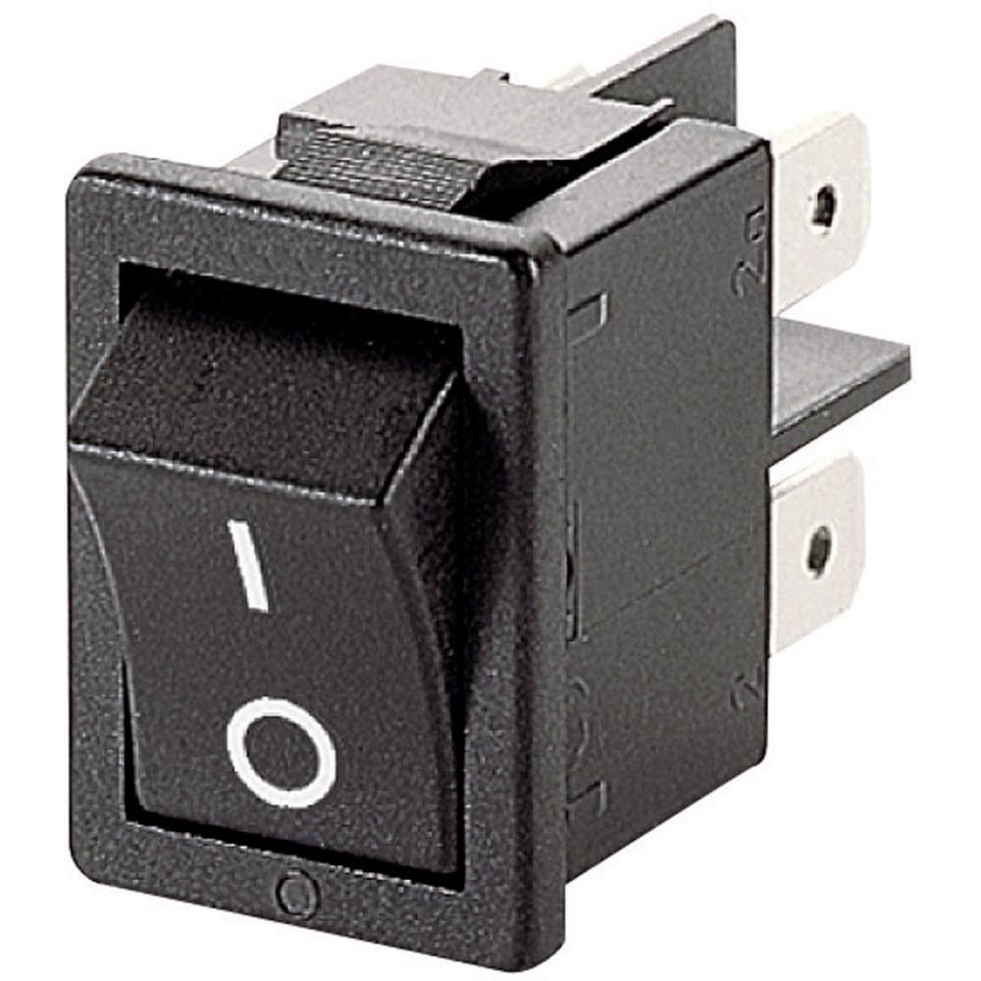
Switches and Buttons
One of the most common uses for GPIOs is to connect switches, especially momentary buttons for user interfaces. Switches can be connected easily, but require some consideration to use properly. The switch is typically connected between a pin and ground, so that pressing on the switch will cause a falling edge. For this to happen, the pin must be biased at VCC. Typically this means using a pull-up, either internal or external. For external switches, a value of 100k is typical. When the switch is open, the voltage at the pin is basically VCC given the small amount of current flowing results in virtually no voltage drop across the pull-up resistor. When the switch is closed, the pin is connected to ground and the pull-up resistor conducts as well. This current is wasted, which is why large values of pull-up resistors are used.
Up to now we have assumed that the switch is a perfect device with a well defined ON and OFF behavior. In reality, most switches are mechanical and are prone to bouncing. The contacts that are being connected together will take some time to settle. During this time, the electrical circuit will connect and disconnect, causing transients to appear at the pin. These transients are often in microseconds, which means that a microcontroller may see hundreds of transitions for just one press of the button. The first solution to this issue is to use a capacitor placed parallel to the switch to debounce it. When the switch is normally open, the capacitor is charged to VCC. When the user presses the switch, the capacitor begins discharging to ground, but does not do so immediately. During this time, the voltage drops off exponentially and only a single transient is seen by the pin. The speed of the transition depends on the RC constant of the pull-up and capacitor, but values of 10nF to 100nF and 100k typically work well.

Slide 11

Physical Interface
UART transmits bits sequentially by pulling the UART line low for a fixed amount of time determined by the baud rate. The UART line when idle is high at the I/O level, 3.3V or whatever the VCC of the MSP430 is set. RS232, on the other hand, uses similar signaling to UART but also incompatible voltage levels (the voltages are high and some are negative) that will damage the MSP430. Therefore, never connect an RS232 device directly to the MSP430. Use a MAX232 or similar device to convert between the two signal level.
The start bits alerts the receiver that data is coming. Without it, if the first bit was a ‘1’, it would be seen as an idle line since an idle UART line is also high. The number of data bits is typically 8, but it can be configured for 7 bits as well. Although some UART receivers can use a different number of bits, only 8 or 8 bits are supported by the MSP430. After the data bits stop bits are sent along with an optional parity bit.
MSP430 families contain different peripherals capable of UART communications.

Slide 12
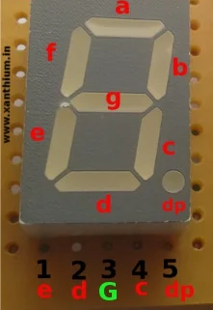
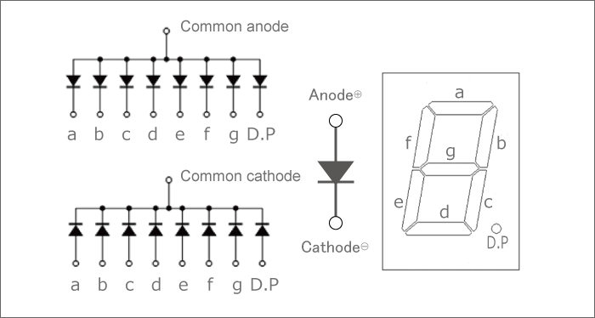
Seven segment displays
A seven-segment LED is a digital display module specialized to display numerical information. Light-emitting diodes (LEDs) arranged in the shape of numbers offer an easily visible display. They are sometimes called "seven-segment displays" or "seven-segment indicators."

Slide 13
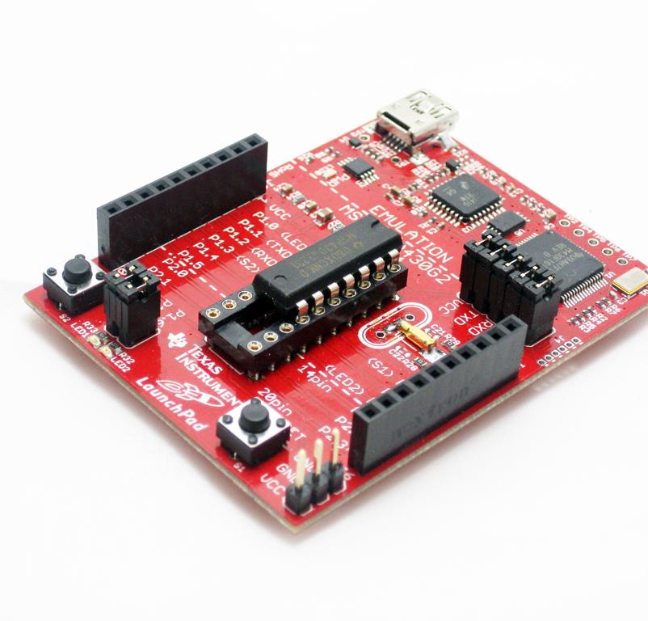
Hardware
The MSP430 GCC compiler is owned by TI and maintained by Mitto Systems since 2018 (it was previously maintained by Somnium and Red Hat). The MSP430 GCC compiler is provided within the MSP430-GCC-OPENSOURCE package.
The free MSP430 GCC compiler does not provide the code size and performance advantages of the optimizing TI compiler found in Code Composer Studio. On average the TI compiler often provides about a 15% code size and performance improvement, as compared to using the free GCC compiler for MSP430; though, these differences can vary significantly from function to function. Please refer to the MSP430 E2E forum for any questions or to provide feedback regarding this product.

Slide 14
APPLICATIONS
It is used in Building & Home Automation Applications. It is used in Grid Infrastructure & Metering Applications. It is used in Portable Test & Measurement Equipment. It also used in Consumer Electronics.
The MSP430 Value Line controllers are cheaper than the higher-end ATMega controllers used in the Arduino platform. You don't need an external crystal, because the MSP430 controllers can run at the full 16 Mhz from their internal clock source.
Light sensing & controlling devices.
Temperature sensing and controlling devices.
Fire detection & safety devices.
Industrial instrumentation devices.
Process control devices

Slide 15
SUMMARY
Capacitive Touch solutions can be implemented in a number of ways on the MSP430
Tradeoff between available peripherals, IO requirements, sensitivity, and power consumption
Capacitive Touch IO (PinOsc function of the digital IO peripheral) in the Value Line family is the most recent peripheral addition.
No external components or connectionsLow power implementation of the relaxation oscillator
The Capacitive Touch library offers several levels of abstraction for different capacitance measurement applications
Raw capacitance measurements Measurements with integrated baseline tracking Button, wheel, and slider abstractions
Download library and examples from www.ti.com/captouch

Slide 16


